Slide 1




OOP - Basics
Classes, Properties, Constructors, Objects, Namespaces
SoftUni Team
Technical Trainers
Software University
http://softuni.bg

Slide 2
Questions
sli.do #PHP-WEB

Slide 3
Check list
IDE + Apache + PHP
read from STDIN
functions
includes

Slide 4


Table of Contents
Classes and Objects in OOP
OOP in PHP
Define Simple Classes
Creating Classes and Objects
Using Namespaces

Slide 5
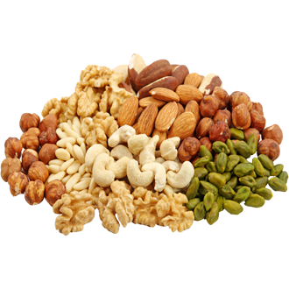
Defining Simple Classes

Slide 6
Classes and Objects
PHP supports Object-Oriented Programming (OOP)
Supports custom classes, objects, interfaces , namespaces, traits
Like other OOP languages (C#, Java, C++)
class Rock {
public $height = 12;
function fall() {
$this->height--;
}
}
$myRock = new Rock();
$myRock->fall();
echo $myRock->height; // 11

Slide 7
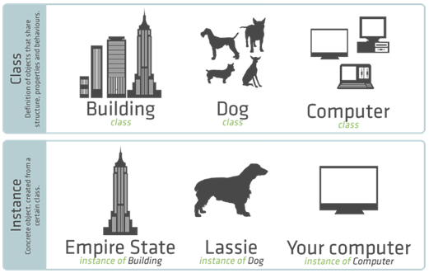
Class Versus Instance
Classes model real-world objects

Slide 8

Properties
Defining and Using Data Properties

Slide 9
Properties
Properties hold the internal object state
They have visibility which should be defined at declaration
class Dog {
public $name;
public $breed;
public $age;
public $children;
}
Property declarations

Slide 10

Constructor
Defining and Using Class Constructor

Slide 11
Defining Constructor
"$this" points to the current instance of the class
class Person {
public $name;
public $age;
function __construct() {
$this->name = null;
$this->age = 0;
}
}
As a rule the constructor should initialize all class properties

Slide 12
Defining Constructor (2)
The constructor may optionally have parameters
class Person {
public $name;
public $age;
function __construct(string $name, $age) {
$this->name = $name;
$this->age = $age;
}
}
Constructor with parameters

Slide 13
Methods
Defining and Using Class Methods

Slide 14
Defining Methods
Methods are classes own functions and define behavior of the class
Simple method with no arguments
class Person {
public $name;
public $age;
function printNames(): void {
echo $this->name . $this->age;
}
}
"void" return type is available since PHP 7.1

Slide 15
Defining Methods (2)
class Person {
public $name;
public $age;
function printNames(string $name): string {
$this->name = $name;
return $this->name;
}
}
Method with parameters

Slide 16
Problem: Define a Bird Class
Create properties
age
weight
flyingSpeed
Create methods to model bird's behavior
breathe()
walk()
fly()

Slide 17
Solution: Define a Bird Class
class Bird {
private $age;
private $weight;
private $flyingSpeed;
public function __construct($age, $weight, $flyingSpeed){
$this->age = $age;
$this->weight = $weight;
$this->flyingSpeed = $flyingSpeed;
}
...

Slide 18
Solution: Define a Bird Class
public function walk() {
echo "Walking" . "\n";
}
public function breath() {
echo "Breathing" . "\n";
}
public function fly() {
echo "Flying" . "\n";
}
}

Slide 19
Anonymous Objects
More on Classes and Objects

Slide 20

Anonymous Objects
The stdClass is an empty generic PHP class for initializing objects of anonymous type (e.g. $obj = new stdClass;)
It is NOT the base class for objects in PHP
Objects can contain their own properties
e.g. $obj->prop = value;
$anonCat = new stdClass;
$anonCat->weight = 14;
echo 'My cat weighs ' . $anonCat->weight . ' kg.';
// My cat weighs 14 kg.

Slide 21
Anonymous Objects – Example
$person = new stdClass;
$person->name = 'Chinese';
$person->age = 43;
$person->weapons = ['AK-47', 'M-16', '9mm-Glock', 'Knife'];
echo json_encode($person);
// {"name":"Chinese", "age":43,"weapons":
["AK-47","M-16","9mm-Glock","Knife"]}
$obj = (object)['name' => 'Peter', 'age' => 25];
$obj->twitter = '@peter';
echo json_encode($obj);
// {"name":"Peter","age":25,"twitter":"@peter"}

Slide 22


Classes and Objects
Live Exercises in class

Slide 23
Namespaces
Namespaces are used to group code (classes, interfaces, functions, etc.) around a particular functionality
Better structure for your code, especially in big projects
Classes, functions, etc. in a namespace are automatically prefixed with the name of the namespace (e.g. MVC\Models\Lib1\Class1)
Using a namespace in PHP:
use CalculationsManager;
$interest = CalculationsManager\getCurrentInterest();
$mysqli = new \mysqli("localhost", "root", "", "world");

Slide 24
Namespaces – Example
<?php
namespace SoftUni {
function getTopStudent() {
return "Pesho";
}
}
namespace NASA {
use SoftUni;
$topSoftUniStudent = SoftUni\getTopStudent();
echo $topSoftUniStudent; // Pesho
}
?>
Declares the use of given namespace
Uses a function from the SoftUni namespace

Slide 25
Namespaces – Example (2)
Define the class in separate file
namespace SoftUni;
class Student {
public $fname = "Gosho";
public $lname = "Pesho";
public function printNames() {
echo $this->fname . $this->lname . "\n";
}
}

Slide 26
Namespaces – Example (2)
Include the previous file
namespace SoftUni2;
require_once 'softuni.php';
use SoftUni\Student;
function createStudent() {
$student = new Student('Gosho', 'Petrov');
return $student;
}
print_r(createStudent());

Slide 27
Namespaces
Exercises in class

Slide 28
Classes and Objects – Example
class Student {
public $name;
public $age;
public function __construct($name = null, $age = null) {
$this->name = $name;
$this->age = $age;
}
}
$peter = new Student("Peter", 21);
echo $peter->name;
$peter->age = 25;
print_r($peter); // Student Object ( [name] => Peter [age] => 25 )
$maria = new Student('Maria');
print_r($maria); // Student Object ( [name] => Peter [age] => )

Slide 29

Summary
Classes define specific structure for objects
Objects are particular instances of a class
Classes define properties, constructor and other members
Constructor is invoked when creating new class instances and initialize the object's internal state
PHP supports classes, objects and anonymous objects
PHP supports namespaces to split program logic into modules

Slide 30







PHP Web Development Basics – Course Overview
https://softuni.bg/courses/php-basics
Notes:
© Software University Foundation – http://softuni.org
This work is licensed under the Creative Commons Attribution-NonCommercial-ShareAlike license.
‹#›

Slide 31

License
This course (slides, examples, demos, videos, homework, etc.) is licensed under the "Creative Commons Attribution-NonCommercial-ShareAlike 4.0 International" license
‹#›
Notes:
© Software University Foundation – http://softuni.org
This work is licensed under the Creative Commons Attribution-NonCommercial-ShareAlike license.
‹#›

Slide 32





Trainings @ Software University (SoftUni)
Software University – High-Quality Education, Profession and Job for Software Developers
softuni.bg
Software University Foundation
http://softuni.foundation/
Software University @ Facebook
facebook.com/SoftwareUniversity
Software University Forums
forum.softuni.bg
Notes:
© Software University Foundation – http://softuni.org
This work is licensed under the Creative Commons Attribution-NonCommercial-ShareAlike license.
‹#›

